Slide 1



Detailed Profile Proposal for 2015/16 presented to the PCC Technical Committee
Cardiology consultation and pathology board – Workflow Definition
Elena Vio, Mauro Zanardini, Claudio Saccavini, Glauco Brandolino (Arsenàl.IT)
November 12, 2015

Slide 2
Aim of Profile
To define a standardized workflow to manage and coordinate remote interaction between multidisciplinary and dynamic team of healthcare professionals (HT composed of network of hubs), with not only a simple sharing of information and digital documents.
The workflow will support and manage the activation of the dynamic HT that allows us to adapt the team to simple or complex cases.

Slide 3





Dynamic Heart team
Patient
Clinical data
Clinical data
Peripheral Hospital
Cardiac surgeon
Peripheral Hospital
Patient
Cardiologist
Support
Highly specialized
Center A
Support
Cardiologist
‪interventional cardiologist‬
Hub network
Cardiac surgeon
Highly specialized
Center B
Highly specialized
Center B
Cardiac surgeon
Support
‪interventional cardiologist‬
Support
Peripheral Hospital
Patient
Clinical data
Peripheral Hospital
Cardiologist
Cardiologist
Clinical data
Patient
‪interventional cardiologist‬
Dynamic HT: Chairperson, professionals, needed clinical documents, priority
Notes:
Proposta basata sulla gestione di un dinamico heart team, dove una rete di hub supporta i siti perfierici cch e/o cch

Slide 4

Specific problems
The professionals can be geographically distant because they may belong to different hospitals
Difficult to communicate and share information
Team’s members can be enrolled in the “Heart Team” dynamically
→Difficult to manage attending to the meeting and preparation of pre-meeting
Clinical protocols are different on base of the disease
→ Difficult to manage the sharing of documents when HT is numerous

Slide 5
Proposed Standards & Systems
Systems that can be involved in the process described above are:
CIS system
Hospital EHR system
HIS
IHE profiles:
XDS.b-I (Cross-Enterprise Document Sharing) for Imaging,
XDS.b (Cross-Enterprise Document Sharing)
DSUB (Document Metadata Subscription): this profile allows to create a notification infrastructure based the XDS.b Infrastructure
XDW (Cross-Enterprise Document Workflow): this profile allows the creation of a Workflow management Infrastructure based on a XDS.b Environment. XDW guidelines provide a flexible tool that can be further profiled (defining a Workflow Definition profile) to manage specific clinical workflows.
Example of CDA that could be used:
[DRPT] - Displayable Reports manages creation and distribution of “display ready” (PDF or CDA) clinical reports from the creating application, to the department, and to the enterprise
[CIRC] - Cardiac Imaging Report Content format for a CDA report of a cardiac diagnostic imaging procedure, including discrete data elements
[CRC] - Cath Report Content format for a CDA report of a cardiac Cath/PCI procedure, including discrete data elements Imagining, radiolog
Notes:
Link to
[DRPT] - Displayable Reports manages creation and distribution of “display ready” (PDF or CDA) clinical reports from the creating application, to the department, and to the enterprise
[CIRC] - Cardiac Imaging Report Content format for a CDA report of a cardiac diagnostic imaging procedure, including discrete data elements
[CRC] - Cath Report Content format for a CDA report of a cardiac Cath/PCI procedure, including discrete data elements
Imagining, radiology

Slide 6
Infrastructure: XDW with a XDS/DSUB
Profile based on the Workflow Definition Template
Notes:
XDS: sharing of documents, such us clinical report, imaging, but also WD.
A Wokflow Definition Profile based on XDW, is a profile that identifies Tasks, Tasks Relationships and Participants involved in a specific workflow.
XDW defines a multi-purpose tool (the Workflow Document) that enables Workflow Definition profile authors to specify additional rules applicable to specific workflows. General rules about the management/sharing of the Workflow Document itself are inherited by the XDW profile.
XDW profile relies on well-established sharing infrastructures (XDS.b, XDR, XCA), and this allows the XDW workflow management infrastructure to take advantage from the whole set of profile identified to empower/support the document sharing itself (Security, Privacy, Auditing, Notification).
DSUB profile provides a Notification Infrastructure that allows triggering notifications when a new document, characterized by specific metadata, is published. Workflow Participants can subscribe their participation to a specific instance of workflow, or they can be notified for any workflow document published that meets specific requirements.
This approach simplifies the Actor requirements of workflow participant: those systems are required just to consume the content of a Workflow Document and update it in accordance to the workflow definition rules

Slide 7
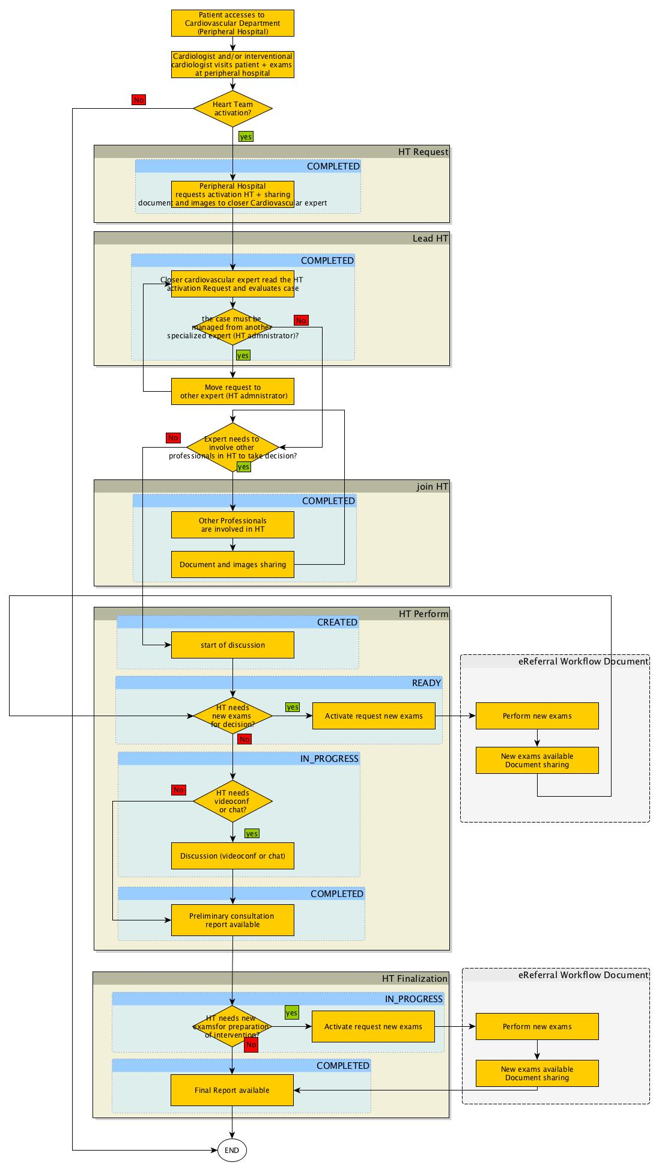
Use Case (1/6)
No Workflow
Start
HT Request
Lead HT
Workflow document
Join HT
HT Perform
HT Finalization

Slide 8
Use Case (2/6)
Start
Workflow document
Lead HT
Join HT
HT Perform
HT Finalization

Slide 9
Use Case (3/6)
HT Request
Workflow document
Join HT
HT Perform
HT Finalization

Slide 10
Use Case (4/6)
HT Request
Lead HT
Workflow document
HT Perform
HT Finalization

Slide 11
Use Case (5/6)
HT Request
Lead HT
Workflow document
Join HT
HT Finalization

Slide 12
Use Case (6/6)
HT Request
Workflow document
Lead HT
Join HT
HT Perform

Slide 13
Use cases
Use cases in Volume 1:
Simple use case with limited HT
1 highly specialized hospital + 1 Peripheral Hospital
planned process
Complex use case with extensive HT
2 highly specialized hospitals + Peripheral Hospital
emergency process

Slide 14
Discussion
Profile Editor:
Mauro Zanardini, mzanardini@consorzioarsenal.it, Arsenàl.IT
Elena Vio, evio@consorzioarzioarsenal.it, Arsenàl.IT
Claudio Saccavini, csaccavini@consorzioarsenal.it, Arsenàl.IT
Glauco Brandolino, gbrandolino@consorzioarsenal.it, Arsenàl.IT
Supporting Resources
Charles Parisot, charles.parisot@med.ge.com, GE
Harry Solomon, Harry.Solomon@med.ge.com, GE
IHE Cardiology Domain

